Slide 1
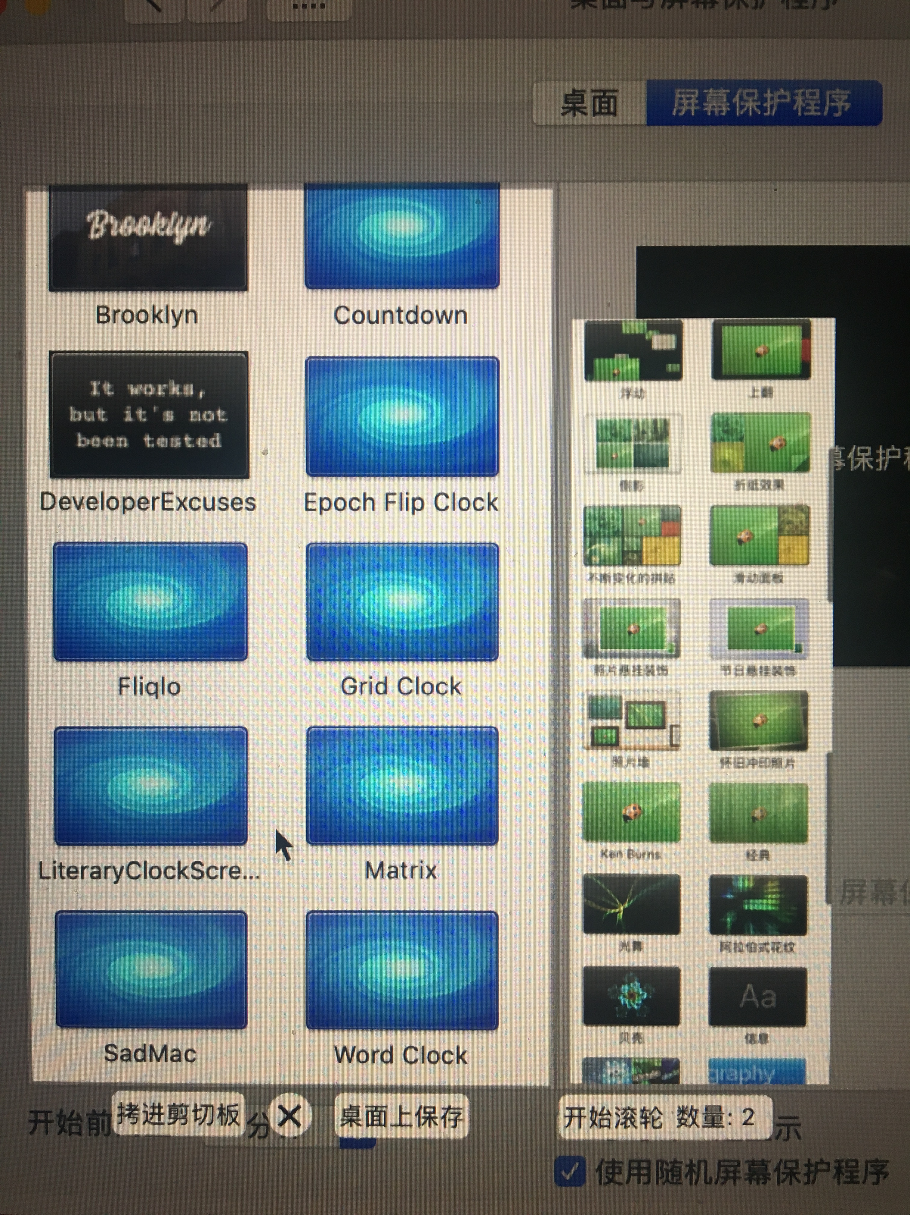
System：Desktop | ScreenSaver
Desktop | ScreenSaver
Copy to Clipboard
Save to Desktop
BetterAndBetter：LongScreenShot
Start Scroll
（auto scroll）
All the highlighted
area should be scrollable
Number of pictures

